Slide 1
File organization and Indexes
Chapter 4
Notes:
1
The slides for this text are organized into chapters. This lecture covers Chapter 8, which introduces and compares several file and index organizations.
This chapter has been completely rewritten in the 3rd edition of the book., with the goal of being a self-contained discussion of the central concepts of files, B trees, and hash indexes, and how to use them effectively in physical database design. It provides a quantitative comparison of the file storage and indexing alternatives, and how they support efficient evaluation of queries, including the concept of “index-only” evaluation plans.
This chapter can be followed by a more in-depth discussion of B-trees, query evaluation, etc. Alternatively, it gives a concise overview of these topics from the perspective of a potential user, and can be used stand-alone in a course that emphasizes building applications over database system architecture. It covers the essential concepts in sufficient detail to support a discussion of physical database design and tuning in Chapter 20.

Slide 2
File organization
File organization: Method of arranging a file of records on external storage.
  Record id (rid) is sufficient to physically locate record
  Indexes are data structures that allow us to find the record ids of records with given values in index search key fields
Architecture: Buffer manager stages pages from external storage to main memory buffer pool. File and index layers make calls to the buffer manager.

Slide 3
Alternative File Organizations
Many alternatives exist, each ideal for some situations, and not so good in others:
  Heap (random order) files: Suitable when typical access is a file scan retrieving all records.
  Sorted Files: Best if records must be retrieved in some order, or only a `range’ of records is needed.
  Indexes: Data structures to organize records via trees or hashing.
    Like sorted files, they speed up searches for a subset of records, based on values in certain (“search key”) fields
    Updates are much faster than in sorted files.
Notes:
2

Slide 4
Cost Model
A cost model that allows us to estimate the cost (in terms of execution time) of different database operations.
For simplicity, we have chosen to concentrate on only the I/O component of cost which gives us a good first approximation to the true costs.
Use a simplistic model in which we just count the number of pages that are read from or written to disk as a measure of I/O. We have ignored the important issue of blocked access - typically, disk systems allow us to read a block of contiguous pages in a single I/O request. The cost is equal to the time required to seek the first page in the block and to transfer all pages in the block.
Notes:
2

Slide 5
Comparing File Organizations
Heap files (random order; insert at eof)
Files sorted on a sequence of fields, (e.g., sorted on <age, sal>)
Hashed files

Slide 6
Operations to Compare
Scan: Fetch all records from disk into the buffer pool.
Equality search: Fetch all records that satisfy an equality selection. Pages that contain qualifying records must be fetched from disk, and qualifying records must be located within retrieved pages.
Range selection: Fetch all records that satisfy a range selection.
Insert a record into the file: identify the page in thefile, fetch that page from disk, insert the new record, then write back the modified page.
Delete a record

Slide 7
Cost Model for Our Analysis
Notations:
  B: The number of data pages
  R: Number of records per page
  D: (Average) time to read or write disk page
  C: (Average) time to process a record
  H: time required to apply the hash function to a record
  - Measuring number of page I/O’s ignores gains of pre-fetching a sequence of pages; thus, even I/O cost is only approximated.
  - Average-case analysis; based on several simplistic assumptions.
  - Typical values today are D =15 milliseconds, C and H =100 nanoseconds; we therefore expect the cost of I/O to dominate.
  Good enough to show the overall trends!
Notes:
3

Slide 8
Analysis
Heap Files:
  Scan: The cost is B(D + RC) because we must retrieve each of B pages taking time D per page, and for each page, process R records taking time C per record.
  Search with equality selection: Suppose that exactly one record matches the desired equality selection (i.e the selection is specified on a candidate key), the record exists and the distribution of values in the search field is uniform.
  For each retrieved data page, we must check all records on the page to see if it is the desired record. The cost is 0.5B(D + RC).
  - If there is no record that satisfies the selection we must scan the entire file to verify this.
  - If the selection is not on a candidate key field, we always have to scan the entire file.
Notes:
4

Slide 9
Analysis (cont.)
Heap Files:
  Search with range selection: The entire file must be scanned. The cost is B(D + RC).
  Insert: We assume that records are always inserted at the end of the file. We must fetch the last page in the file, add the record, and write the page back. The cost is 2D + C.
  Delete: We must find the record, remove the record from the page, and write the modified page back. We assume that no attempt is made to compact the file to reclaim the free space created by deletions, for simplicity. The cost is the cost of searching plus C + D.
Notes:
4

Slide 10
Sorted Files:
  Scan: The cost is B(D + RC) because all pages must be examined.
  Search with equality selection: We assume that the equality selection is specified on the field by which the file is sorted; if not, the cost is identical to that for a heap file. We can locate the first page containing the desired record or records, should any qualifying records exist, with a binary search in log₂B steps. Assumes that we can retrieve the i^{th} page on the file directly in one disk I/O. Once the page is known, the first qualifying record can again be located by a binary search of the page at a cost of Clog₂R. So, The cost is Dlog₂B + Clog₂R.
  If there are several qualifying records, the cost includes the cost of locating the first such record (Dlog₂B+Clog₂R) plus the cost of reading all the qualifying records in sequential order (because they are adjacent to each other due to the sorting).
Notes:
4

Slide 11
Sorted Files:
  Search with range selection: Again assuming that the range selection is on the sort field. The cost is similar to that of equality search with many qualifying records.
  Insert: On average, we can assume that the inserted record belongs in the middle of the file. Thus, we must read the latter half of the file and then write it back after adding the new record. The cost is therefore the cost of searching to find the position of the new record plus 2 * (0.5B(D + RC)), that is, search cost plus B(D + RC).
  Delete: The cost is the same as for an insert, that is, search cost plus B(D + RC).
  If records to be deleted are specified by an equality or range condition, the cost of deletion depends on the number of qualifying records.
Notes:
4

Slide 12
Hashed Files:
Assume that there are no overﬂow pages.
  Scan: In a hashed file, pages are kept at about 80% occupancy This is achieved by adding a new page to a bucket when each existing page is 80% full, when records are initially organized into a hashed file structure. Thus, the cost of scanning all the data pages, is about 1.25 times the cost of scanning an unordered file, that is, 1.25B(D + RC).
  Search with equality selection: This operation is supported very efficiently if the selection is on the search key for the hashed file (Otherwise, the entire file must be scanned). The cost of identifying the page that contains qualifying records is H; assuming that this bucket consists of just one page (i.e., no overﬂow pages), retrieving it costs D. The cost is H + D +0.5RC if we assume that we find the record after scanning half the records on the page.
Notes:
4

Slide 13
Hashed Files:
  Search with range selection: The hash structure offers no help; even if the range selection is on the search key, the entire file must be scanned. The cost is 1.25B(D + RC).
  Insert: The appropriate page must be located, modified, and then written back. The cost is the cost of search plus C + D.
  Delete: We must search for the record, remove it from the page, and write the modified page back. The cost is again the cost of search plus C + D (for writing the modified page).
Notes:
4

Slide 14
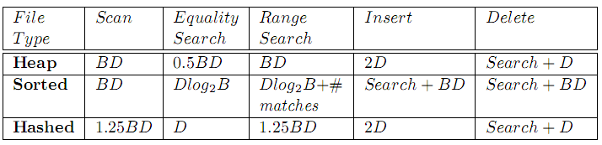
Choosing a File Organization
Heap file: good storage efficiency and supports fast scan, insertion, and deletion of records. However, it is slow for searches.
Sorted file: good storage efficiency. It is quite fast for searches, and it is the best structure for range selections. But insertion and deletion of records is slow.
Hashed file: insertions and deletions are fast, and equality selections are very fast. But, no support for range selections, and full file scans are a little slower.
Notes:
5

Slide 15
Indexes
An index on a file speeds up selections on the search key fields for the index.
  Any subset of the fields of a relation can be the search key for an index on the relation.
  Search key is not the same as key (minimal set of fields that uniquely identify a record in a relation).
An index contains a collection of data entries, and supports efficient retrieval of all data entries k* with a given key value k.
  Given data entry k*, we can find record with key k in at most one disk I/O.
Notes:
7

Slide 16
B+ Tree Indexes
Non-leaf
Pages
Leaf
Pages
(Sorted by search key)
Leaf pages contain data entries, and are chained (prev & next)
Non-leaf pages have index entries; only used to direct searches:
index entry
P
K
P
K
P
K
P
m
0
1
1
2
2
m
Notes:
4

Slide 17
Example B+ Tree
Root
Note how data entries
in leaf level are sorted
17
Entries <= 17
Entries > 17
5
13
27
30
2*
3*
5*
7*
8*
14*
16*
22*
24*
27*
29*
33*
34*
38*
39*
Find 28*? 29*? All > 15* and < 30*
Insert/delete: Find data entry in leaf, then change it. Need to adjust parent sometimes.
  And change sometimes bubbles up the tree
Notes:
15

Slide 18
Hash-Based Indexes
Good for equality selections.
Index is a collection of buckets.
  Bucket = primary page plus zero or more overflow pages.
  Buckets contain data entries.
Hashing function h: h(r) = bucket in which (data entry for) record r belongs. h looks at the search key fields of r.
Notes:
2

Slide 19
Alternatives for Data Entry k* in Index
In a data entry k* we can store:
  Data record with key value k, or
  <k, rid of data record with search key value k>, or
  <k, list of rids of data records with search key k>
Choice of alternative for data entries is orthogonal to the indexing technique used to locate data entries with a given key value k.
  Examples of indexing techniques: B+ trees, hash-based structures
  Typically, index contains auxiliary information that directs searches to the desired data entries
Notes:
8

Slide 20
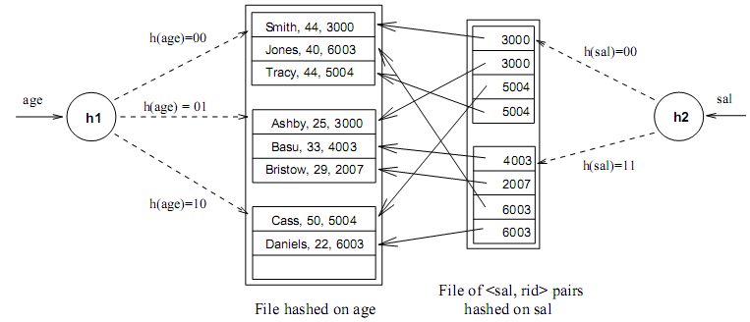
Alternatives for Data Entries (Contd.)
Notes:
9

Slide 21
Alternatives for Data Entries (Contd.)
Alternative 1:
  If an index uses Alternative(1), there is no need to store the data records separately, in addition to the contents of the index.
  We can think of such an index as a special file organization that can be used instead of a sorted file or a heap file.
Notes:
9

Slide 22
Alternatives for Data Entries (Contd.)
Alternatives 2 and 3:
  Data entries typically much smaller than data records. So, better than Alternative 1 with large data records, especially if search keys are small. (Portion of index structure used to direct search, which depends on size of data entries, is much smaller than with Alternative 1.)
  Alternative 3 more compact than Alternative 2, but leads to variable sized data entries even if search keys are of fixed length.
Notes:
10

Slide 23
Index Classification
Primary vs. secondary: If search key contains primary key, then called primary index.
  Unique index: Search key contains a candidate key.
Clustered vs. unclustered: If order of data records is the same as, or `close to’, order of data entries, then called clustered index.
  Alternative 1 implies clustered; in practice, clustered also implies Alternative 1 (since sorted files are rare).
  A file can be clustered on at most one search key.
  Cost of retrieving data records through index varies greatly based on whether index is clustered or not!
Notes:
11

Slide 24
Clustered vs. Unclustered Index
An index that uses Alternative(2) or Alternative(3) can be a clustered index only if the data records are sorted on the search key field.
Otherwise, the order of the data records is random, defined purely by their physical order, and there is no reasonable way to arrange the data entries in the index in the same order.
Indexes based on hashing do not store data entries in sorted order by search key, so a hash index is clustered only if it uses Alternative(1).
Indexes that maintain data entries in sorted order by search key use a collection of index entries, organized into a tree structure, to guide searches for data entries, which are stored at the leaf level of the tree in sorted order.
Notes:
12

Slide 25
Clustered vs. Unclustered Index
A data file can be clustered on at most one search key, which means that we can have atmost one clustered index on a data file.
CLUSTERED
UNCLUSTERED
Index entries
direct search for
data entries
Data entries
Data entries
Data Records
(Index File)
(Data file)
Data Records
Notes:
12

Slide 26
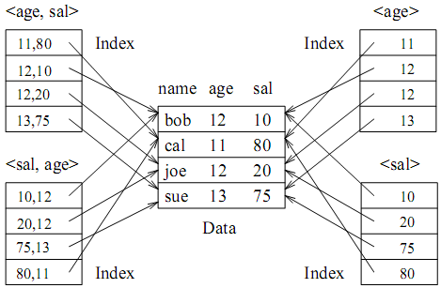
Indexes with Composite Search Keys
The search key for an index can contain several fields; such keys are called composite search keys or concatenated keys.
Example.
Notes:
13

Slide 27
Indexes with Composite Search Keys
Composite Search Keys: Search on a combination of fields.
  Equality query: Every field value is equal to a constant value. E.g. wrt <sal,age> index:
    age=20 and sal =75
  Range query: Some field value is not a constant. E.g.:
    age =20; or age=20 and sal > 10
Examples of composite key
indexes using lexicographic order.
11,80
11
12,10
12
12,20
name
age
sal
12
13,75
bob
12
10
13
<age, sal>
cal
11
80
<age>
joe
12
20
10,12
sue
13
75
10
20,12
Data records
sorted by name
20
75,13
75
80,11
80
<sal, age>
<sal>
Data entries in index
sorted by <sal,age>
Data entries
sorted by <sal>
Notes:
13

Slide 28
Composite Search Keys
To retrieve Emp records with age=30 AND sal=4000, an index on <age,sal> would be better than an index on age or an index on sal.
If condition is: 20<age<30 AND 3000<sal<5000:
  Clustered tree index on <age,sal> or <sal,age> is best.
If condition is: age=30 AND 3000<sal<5000:
  Clustered <age,sal> index much better than <sal,age> index!
Composite indexes are larger, updated more often.
Notes:
20

Slide 29
INDEX SPECIFICATION IN SQL-92
The SQL-92 standard does not include any statement for creating or dropping index.
In practice, every commercial relational DBMS supports one or more kinds of indexes.
Once the index is created, it is automatically maintained by the DBMS adding/removing data entries in response to inserts/deletes of records on the Students relation.
The following command to create a B+ tree index.
CREATE INDEX IndAgeRating ON Students
WITH STRUCTURE = BTREE,
KEY =(age, gpa)
Notes:
11

Slide 30
Assigments.
Index specification SQL Server / Oracle?
Notes:
11

